Slide 1

ANALYSIS OF SERVICE QUALITY ON
ALLEANZA ASSICURAZIONI S.P.A. AGENCY OF NOVAFELTRIA
Customer Relationship Management Professor: Marco Visentin | Raed Bou Salman Lucía Benedito Orquín Giovanni Paolo Colella Camilla Dalmoro Saksham Joshi Camilla Elisabetta Ranghetti

Slide 2






OUR TEAM
Camilla Dalmoro
Lucia Benedito Orquin
Camilla Elisabetta Ranghetti
Giovanni Paolo Colella
Raed Bou Salman
Saksham
Joshi

Slide 3
THE COMPANY
It is one of the largest Italian insurance companies, with a portfolio of almost 2 million clients and a network of 12,000 consultants and collaborators, it operates throughout Italy.
Mission - consultants customise solutions according to clients' needs and habits, offering integrated and personalised insurance solutions of protection, advice and service.
Vision - protect and improve people's quality of life through the mitigation of risks for individuals and institutions, creating value.
Alleanza focuses on 4 areas:
Protection
Supplementary pensions
Savings
Investment

Slide 4

RESEARCH QUESTION
Our goal was to measure the customer’s perception of service quality for insurance and investments services provided by Alleanza Assicurazioni S.p.a, Agency of Novafeltria through 4 dependent variables:
-Intention to continue the relationship
-Cross-selling
-Satisfaction
- Overall quality

Slide 5
STRUCTURE
Interpretation of Results
2nd Stage Questionnaire
1st Stage Questionnaire
Meaning of results
Conclusions
Confirmation of the hypotheses
35 questions
100 people surveyed
82 people answered
Explanatory Factor Analysis
9 questions
40 people surveyed
30 people answered
Analysis of the data, representative of the customer base

Slide 6
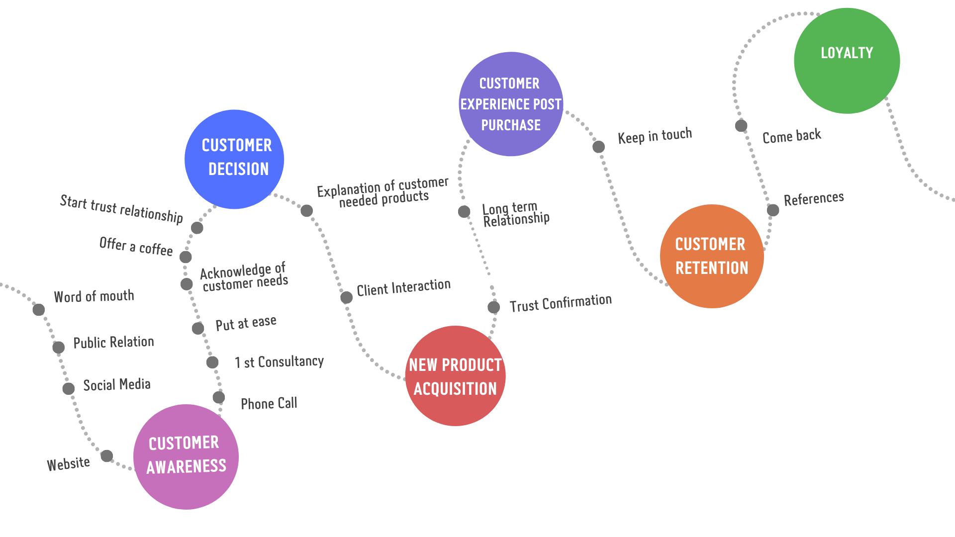
CUSTOMER JOURNEY
CUSTOMER JOURNEY

Slide 7
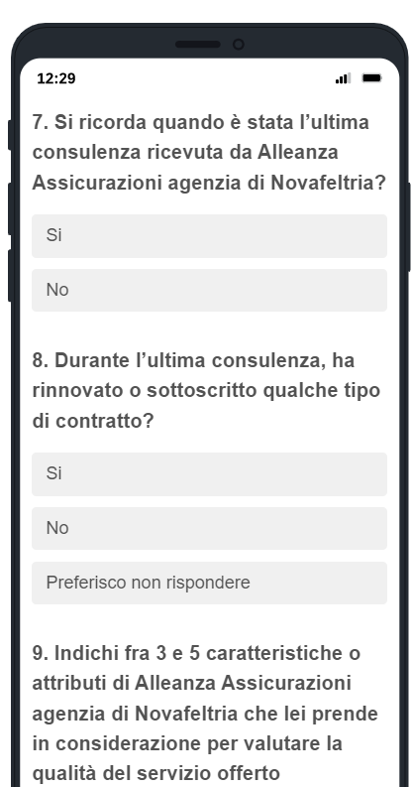
PRELIMINARY SURVEY
The first step was to submit a qualitative questionnaire in order to examine the quality perceived by the customers of Alleanza Assicurazioni S.p.a Agency of Novafeltria.
The questionnaire was formed by:
Demographic questions
Queuing questions
Open questions

Slide 8
FOCUS OF 1ST STAGE ANALYSIS
1
2
3
4
5
6
Sentiment Analysis
T-test Analysis
Chi-Squared Analysis
Demographics
Queuing
Categorization
- Gender
- Age
- Location
- Study Background
- Occupation
- Number of family members
- Word Cloud
- Top 5 most frequent words
- Age & Gender
- Age & Renew Contract
-Remember last consulting
-Renew contract
- Emotional States
-Investigate the relationship
of two categorical variables

Slide 9
01 DEMOGRAPHICS
30 answers collected
53.3%
GENDER
46.6%
23.3%
Novafeltria
LOCATION
36.6%
Outside Novafeltria
Average age 39 yo
Minimum age 20 yo
Maximum age 68 yo
AGE

Slide 10
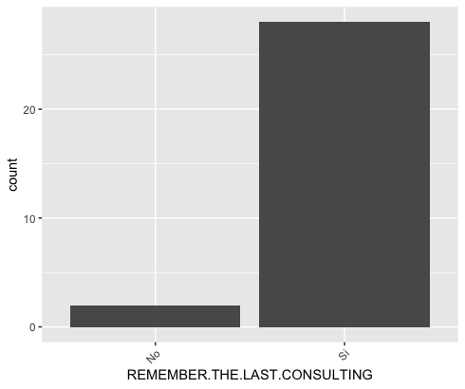
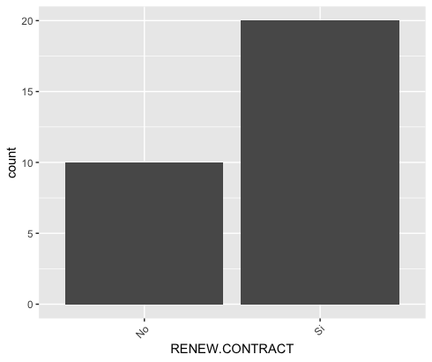
02 QUEUING
Remember last consulting
Renew contract
93.3% remembered its last consulting meeting
66.6% of the respondents has renewed a contract with the company

Slide 11
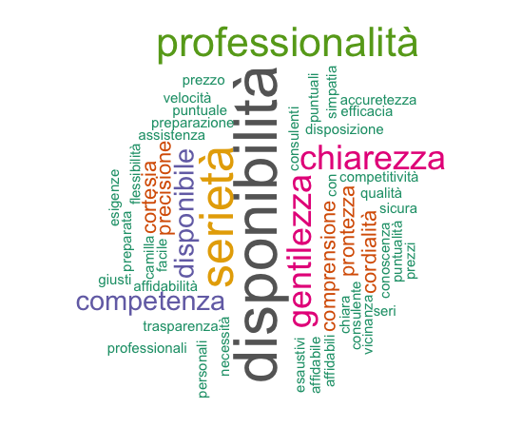
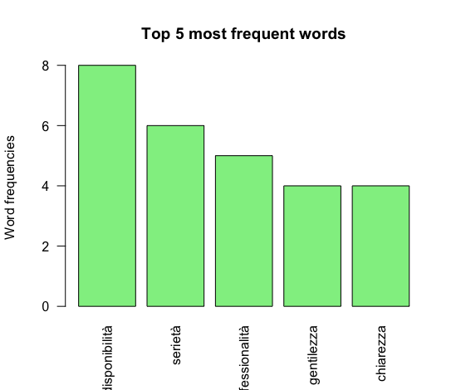
03 CATEGORIZATION
Word Cloud
Frequent words
13 characteristics stated by people in the survey
Most frequent words mentioned in the word cloud: availability, earnestness, professionalism, kindness, and clarity

Slide 12
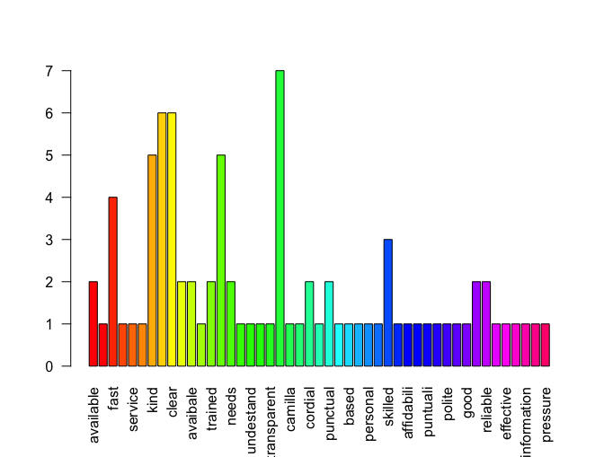
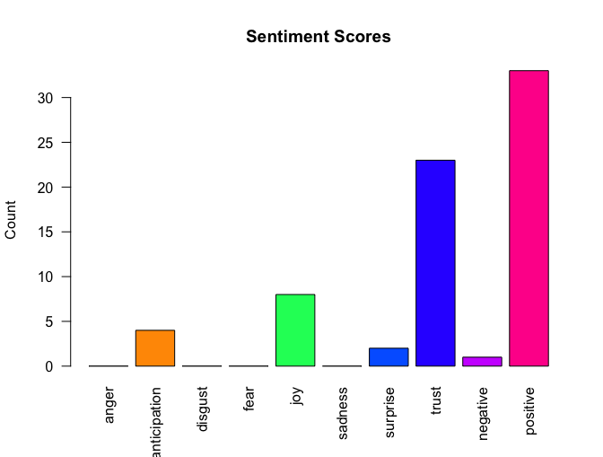
04 SENTIMENT ANALYSIS
Sentiment Analysis
Sentiment Scores
Customer service (the consultancy) is a differentiator in this insurance agency
Sentiments that received the highest scores were positive and trust, followed by joy, anticipation, and surprise.

Slide 13
06 CHI-SQUARED ANALYISIS
Rest of relationship of 2 categorical variables
No association among both variables
Chi-squared test
Age & Occupation
Association among both variables
Influences the customer's propensity to buy one type of product rather than another

Slide 14
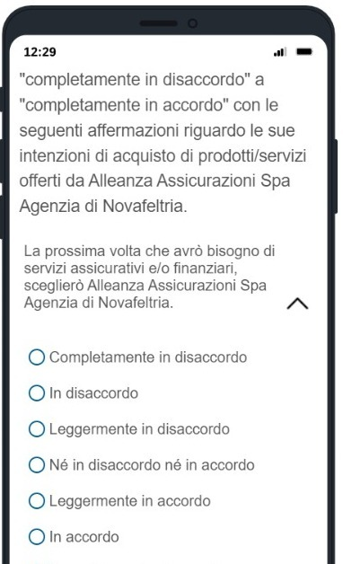
2° QUESTIONNAIRE
The second step was to submit a questionnaire made of questions assessed in a Likert Scale and a Semantic Differential Scale..
The questionnaire was formed by:
Queuing questions
Dependent variable questions
Independent variable questions
Demographics

Slide 15
OUTCOMES OF 2ND STAGE ANALYSIS
1
2
3
4
5
6
Demographics
Queuing
T- Analysis
Chi-Squared Analysis
EFA Analysis
Linear Model
- Gender
- Age
- Location
- Study Background
- Occupation
- Number of family members
- Age & Gender
- Age & Renew Contract
- Dependent variables
- Independent variables
- Remember last consulting
- Renew contract
- Investigate the relationship
of two categorical variables
- Mediation
- Performance Importance
- Matrix

Slide 16
82 answers collected
01 DEMOGRAPHICS
50%
GENDER
50%
36.51%
Novafeltria
LOCATION
23.31%
Outside Novafeltria
Average age 37 yo
Minimum age 20 yo
Maximum age 68 yo
AGE

Slide 17
04 CHI-SQUARED ANALYSIS
BETWEEN | CHI – SQUARED TEST OUTPUT | CONCLUSION
Study background vs Occupation | X-squared = 52.91 d.f. = 32 P-value = 0.0115 | Reject null hypothesis
Means that:
“Educational qualification determines employment status, and consequently income, and whether this relationship influences the choice of type of insurance and/or financial product”

Slide 18
05 EFA DEPENDENT VARIABLES
Intention
The behaviour of repurchasing financial or insurance products and services or continuing the relationship
2
Cross-selling
Purchasing different products with respect to the usual product portfolio purchased
2
When the emotion surrounding disconfirmed expectations is coupled with the consumer’s prior feelings about the experience
Satisfaction
3
Quality
Overall impression of the relative inferiority or superiority of the organization and services offered
2

Slide 19
DEPENDENT VARIABLES
Factor (Item number) | Text of the item | Inter item correlation (Min-Max) | Factor loadings | Cronbach alpha
Intention (2) | La prossima volta che avrò bisogno di servizi assicurativi e/o finanziari, sceglierò Alleanza Assicurazioni S.p.a Agenzia di Novafeltria. | 0,9 | 0,789 | 0,94711
 | Se in futuro dovessi utilizzare dei servizi assicurativi e/o finanziari, sceglierò Alleanza Assicurazioni Spa Agenzia di Novafeltria. | 0,9 | 0,894
Cross-selling (2) | In futuro acquisterò da Alleanza Assicurazioni S.p.a Agenzia di Novafeltria dei prodotti assicurativi/finanziari diversi da quelli che già possiedo. | 0,83 | 0,937 | 0,90167
 | Penso che sia molto probabile che acquisterò da Alleanza Assicurazioni S.p.a Agenzia di Novafeltria dei prodotti assicurativi/finanziari diversi da quelli che già possiedo. | 0,83 | 0,804

Slide 20
DEPENDENT VARIABLES
Factor (Item number) | Text of the item | Inter item correlation (Min-Max) | Factor loadings | Cronbach alpha
Satisfaction (3) | Se avessi bisogno di servizi assicurativi e/o finanziari, sarei soddisfatto/a dei servizi offerti da Alleanza Assicurazioni S.p.a Agenzia di Novafeltria. | 0,71 – 0,80 | 0,694 | 0,91344
 | In generale, se dovessi acquistare dei servizi assicurativi e/o finanziari, sarei soddisfatto/a dei servizi offerti da Alleanza Assicurazioni S.p.a Agenzia di Novafeltria. | 0,80 – 0,85 | 0,875
 | Credo che i servizi offerti da Alleanza Assicurazioni S.p.a Agenzia di Novafeltria siano soddisfacenti. | 0,71 – 0,85 | 0,662
Quality (2) | Nel complesso, considero i servizi offerti da Alleanza Assicurazioni S.p.a Agenzia di Novafeltria eccellenti. | 0,68 | 0,732 | 0,80061
 | La qualità del servizio di Alleanza Assicurazioni S.p.a Agenzia di Novafeltria è generalmente. | 0,68 | 0,615

Slide 21
05 EFA INDEPENDENT VARIABLES
Dependent variables
EFA
Independent variables
Trust
Consultants
Service
The first sections of the questionnaire related to
intention, cross-selling, satisfaction and quality
are considered dependent variables.
In order to identify the independent variables,
we ran an exploratory factor analysis which provided us with consultants, service and trust.

Slide 22
INDEPENDENT VARIABLES
Factor (Item number) | Text of the item | Inter item correlation (Min-Max) | Factor loadings | Cronbach alpha
Trust (3) | I prodotti offerti da Alleanza Assicurazioni S.p.a Agenzia di Novafeltria sono competitivi. | 0,49 – 0,58 | 0,580 | 0,78739
 | Alleanza Assicurazioni S.p.a Agenzia di Novafeltria mantiene le promesse fatte ai clienti. | 0,58 – 0,66 | 0,756
 | Alleanza Assicurazioni S.p.a Agenzia di Novafeltria considera il mio benessere quando prende decisioni rispetto ai prodotti/servizi offerti. | 0,49 – 0,66 | 0,748
Consultants (2) | I consulenti di Alleanza Assicurazioni S.p.a Agenzia di Novafeltria non sono chiari. | 0,49 | 0,523 | 0,65105
 | I consulenti di Alleanza Assicurazioni S.p.a Agenzia di Novafeltria non sono competenti. | 0,49 | 0,950
Service (3) | I consulenti di Alleanza Assicurazioni Spa Agenzia di Novafeltria sono disponibili. | 0,61 – 0,71 | 0,614 | 0,86497
 | Il servizio di Alleanza Assicurazioni Spa Agenzia di Novafeltria è professionale. | 0,71 – 0,75 | 0,804
 | I consulenti di Alleanza Assicurazioni Spa Agenzia di Novafeltria sono gentili. | 0,61 – 0,75 | 0,793

Slide 23
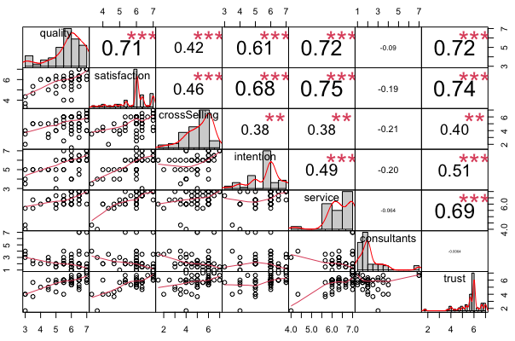
06 LINEAR MODEL
From the figure we can say that the relations are all statistically significant.
Only the variable “Consultants” resulted in all negative relations, but it is justified by the fact that the items used to assess it were presented with negative wording in relation to the services provided by the company.

Slide 24
06 LINEAR MODEL
Mediation
INTENTION
CROSS-SELLING
There is a
partial mediation
from “Satisfaction”.
There is a
full mediation
from “Satisfaction”.
All the tests had “Quality” as independent variable and “Satisfaction” as mediator.

Slide 25
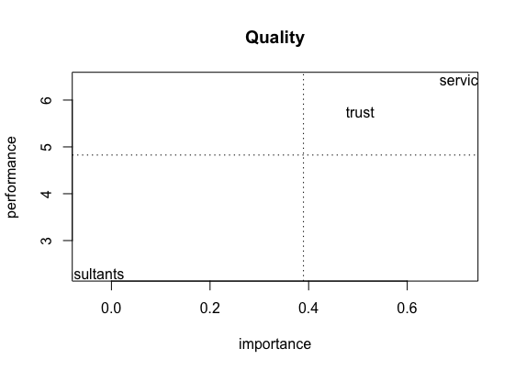
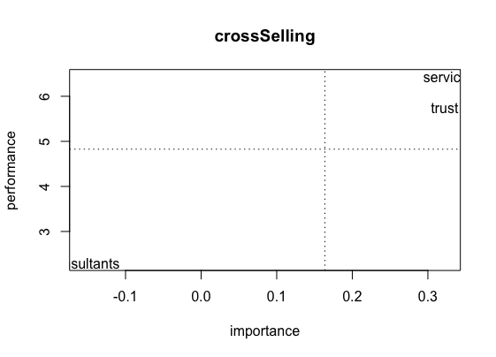
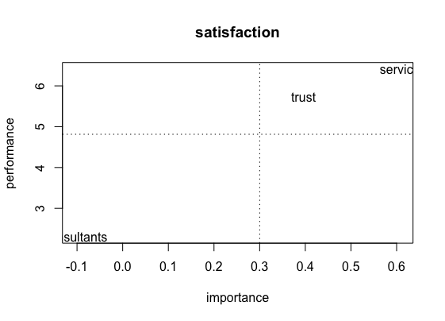
MANAGERIAL IMPLICATIONS
Here we presented variables “Quality”, “Cross-selling” and “Satisfaction” in relation to the performance and importance of “Trust”, ”Service” and “Consultants”.
This structure is given by the analysis of the mediation model and this explain why “Intention” is not present since “Intention” is explained by 50% by “Quality” and “Satisfaction”.

Slide 26
FINAL CONCLUSIONS
We are enhancing the philosophy of Alleanza Assicurazioni S.p.a Agency of Novafeltria regarding the consultancy;
Customers’ expectations rise to receive more benefits and better quality of service;
Factors such us “Cross-selling” gives to the company an insight of how to structure a more efficient customer targeting in order to propose additional products to the one that a client already has.

Slide 27

Thank you for your attention

Slide 28
RESOURCES
Colucci. M. & Visentin. M, (2017). "Style and substance: a case study of the expansion of mature business-to-business relationships in the Italian clothing industry “. Journal of Business & Industrial Marketing, Vol. 32 Issue: 1, pp.153-166. University of Bologna.
Ismail.A; Muhammad Madi Bin Abdullah; Sebastian K.F. (2009). “Exploring the relationships among service quality features, perceived value and customer satisfaction”. Journal of Industrial Engineering and Management (JIEM), ISSN 2013-0953, OmniaScience, Barcelona, Vol. 2, Iss. 1, pp. 230-250.
Mohammed Naved Khan and Mohd Adil. (2013). “Data Analysis Techniques in Service Quality Literature: Essentials and Advances”. Serbian Journal of Management. Aligarh Muslim University (India), Volume 8, Number 1, pp. 95 – 112.
Parasuman. A, Zeithaml. V. & Berry. L, (1988). “SERVQUAL: A Multiple-Item Scale for Measuring Consumer Perceptions of Service Quality”. Journal of Retaling, Volume 64, Number 1. Marketing Science Institute, Cambridge.
Steven. A. Taylor & Tomas. L. Baker, (1994). “An Assessment of the Relationship between Service Quality and Customer Satisfaction in the Formation of Customer’ Purchase Intentions”. Journal of Retaling, Volume 70, Number 2, pp. 163-178. New York University.

